Slide 1
Evolution
A brief overview
(updated 2-1-2022)

Slide 2
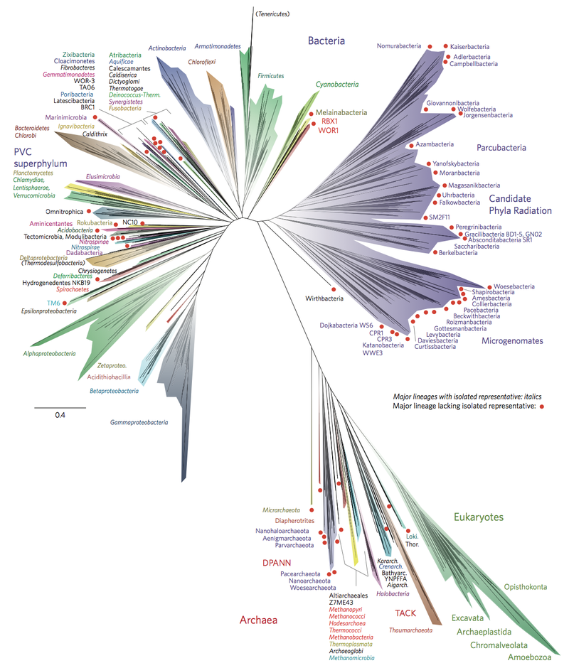
Tree of life

Slide 3
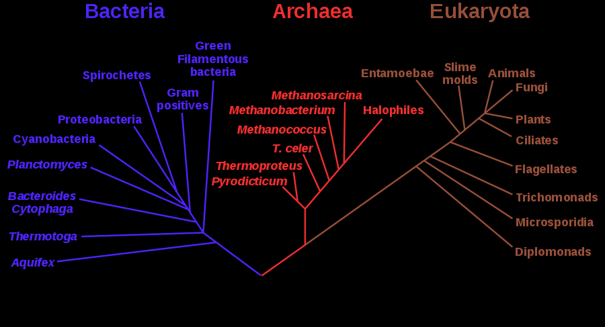
Rooted tree for rRNA genes

Slide 4
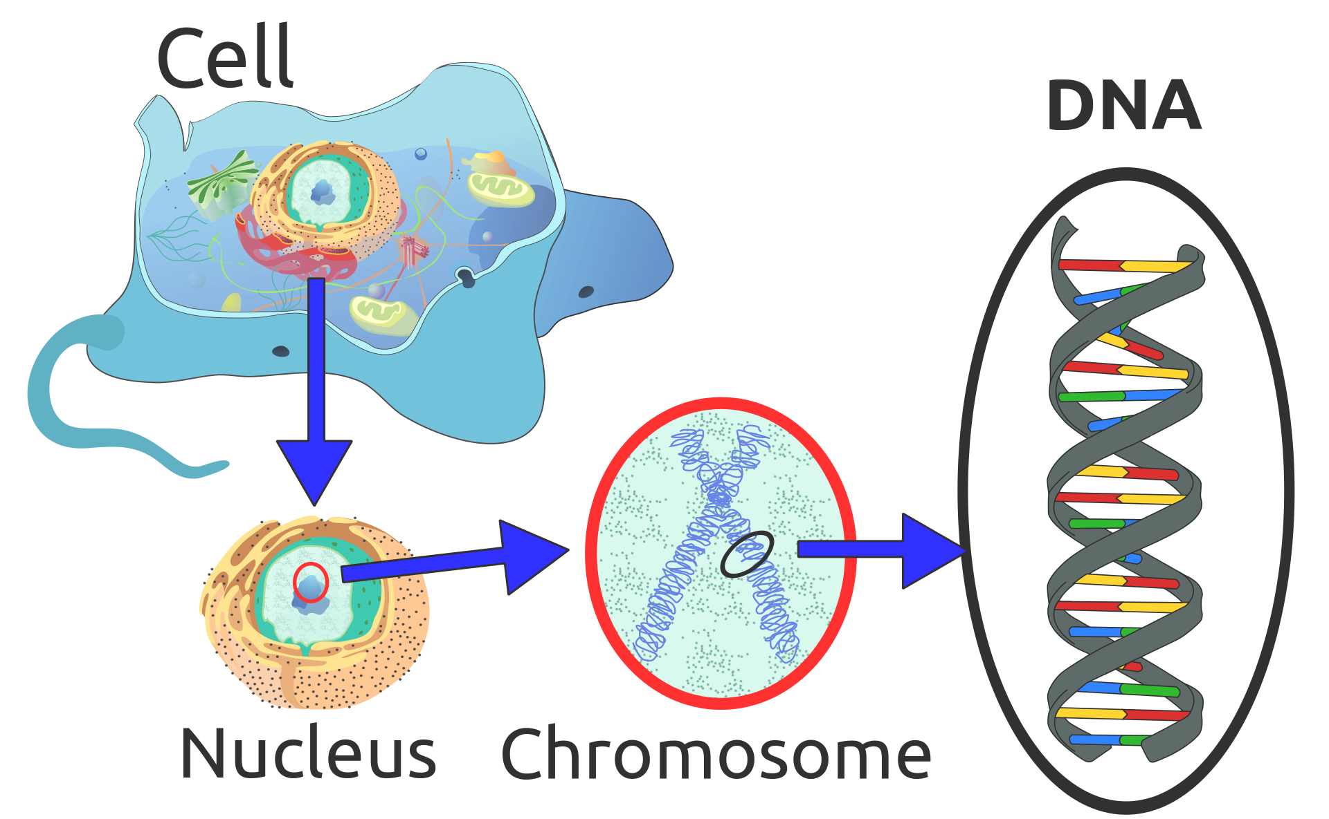
Cell, Nucleus, Chromosome, DNA

Slide 5
Genetics terminology
Cell nucleus contains DNA (double helix, G-A-C-T alphabet of nucleotides); mitochondrial DNA also exists outside the nucleus
Gene: a sequence of coding regions (exons) within DNA, separated by introns
Proteins: sequences composed of 20 characters (amino acid alphabet)
Gene expression: results in generating proteins from genes in DNA
Promoter regions: adjoin genes, determining how much of each protein gets expressed, depending on what is sensed within the cell

Slide 6
Genetic inheritance
Offspring inherit the genes of parents, with a small probability of mutation everywhere in the gene.
Diploidy: one variant of a gene (“allele”) may dominate the other.
Recombination/crossover: pieces of chromosomes coming from different parents combine to form the offspring chromosomes.

Slide 7
What we see may not be what we get!
Traits are observable features of organisms.
Traits are determined by genes and environmental factors.
Genes (“genotype”) are inherited, not traits (“phenotype”) .
Examples:
If you have alleles of genes for musculature that facilitates long-distance running, your children may inherit those genes.
If you run a lot, the exercise will improve your muscles, but not your future child’s muscles!
If a pregnant person imbibes harmful drugs, those pass through the placenta and influence the expression of genes, even if the genes are not altered.
Malnutrition can affect children, but effects can be reversed in the the next generation.

Slide 8
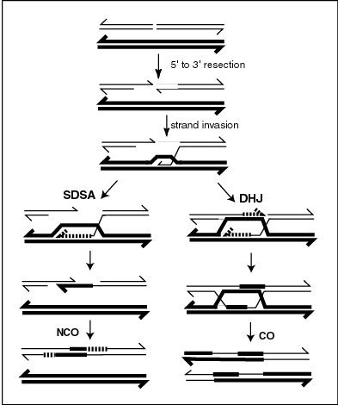
Recombination
Exchange of genetic material between different organisms.
Involves pairing of homologous (similar) chromosomes.
Two possible repair mechanisms:
SDSA pathway: donating chromosome not changed; no crossover (NCO).
DHJ pathway: crossover (CO).

Slide 9
Species
Each species has sufficient homogeneity in DNA (and traits) to readily permit sexual reproduction resulting in fertile offspring.
Random variations exist within a species.
Some species include “micro-species”.
Hybridization can result in new organisms that may not fall readily into any category.
All boundaries are arbitrary and fuzzy: you can trace your origin to single-celled organisms, through a long sequence of ancestors, but you cannot mate with them!

Slide 10
Fitness
Measures how well an organism is adapted to its environment, in terms of its success in surviving and reproducing.
Biologically, one simple measurement is the number of grandchildren of an individual.
The effect of some helpful alleles may be counteracted by others, so that the individuals (in which they occur) have low fitness; hence these alleles may die away.
There are no ethical considerations here, no moral imperative towards fitter individuals or species!

Slide 11
Fitness is relative to others
Most environments have limited resources.
The population of a species cannot grow indefinitely without exhausting available resources.
Organisms compete with others in the same “niche”, especially with those in the same species and geographical location.
We should ask how much more successful is an individual compared to others, rather than in absolute terms.

Slide 12
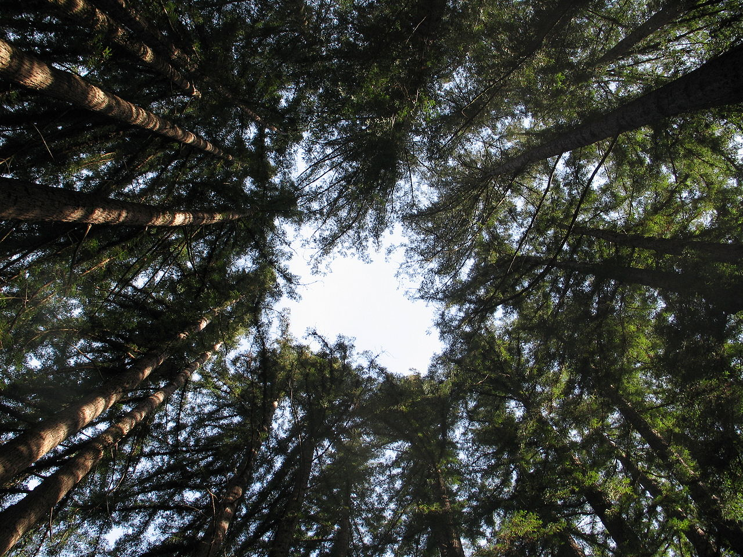
Example
Trees in the redwood forest are competing for sunlight.
Competition with their neighbors results in the taller ones getting a little more sunlight, hence higher fitness.
The results of evolution are sometimes irrational and result in wasted resources: these trees would have received the same amount of sunlight if all of them were just a few feet tall!
(Another analogy: how loudly should people talk in a crowded restaurant?)
Redwood Forest (CA)

Slide 13
Gene combinations
High fitness may depend on a combination of genes, not just one.
Example: a long neck may require a long tail; but just a long tail may not help.
Simultaneous mutations in multiple genes occur, though rarely.
A circuitous path may occur in evolution, e.g., one body part may evolve for one purpose, later co-opted for another purpose, facilitated by a new mutation affecting another body part.
Some genes sit together on a chromosome, facilitating their simultaneous mutation (and travel together into an offspring).

Slide 14
Mutations
Copying genes from parents to children (during reproduction) is imperfect: a small number of “mutations” (copying errors) occur.
Some mutations result in non-viable offspring that cannot survive; most mutations are harmless; a small number can actually improve fitness (e.g., a longer neck may help an animal reach the tops of trees).
The number of individuals with such advantageous gene mutations increases with time, eventually dominating the population.
Nothing is deterministic: Survival and reproductive opportunities are also driven by chance (random events).

Slide 15
Mbzbidel shm nfnregde
The above was generated after replacing ten letters randomly by others.
Guess what was the original sentence!

Slide 16
Kombidet tnib cemtonca
The above was generated after replacing ten letters randomly by others, subject to some constraints on these mutations.
Guess what was the original sentence!
Was this task easier or harder than the previous one?
Why?

Slide 17
Point Mutations (successively replacing vowels by vowels, & consonants mostly by “similar” consonants)
Consider this sentence.
Conbider this sentence.
Conbider tnis sentence.
Conbider tnis semtence.
Conbider tnis semtance.
Conbider tnib semtance.
Conbidet tnib semtance.
Konbidet tnib semtance.
Kombidet tnib semtance.
Kombidet tnib semtanca.
Kombidet tnib cemtonca.

Slide 18
Exercise:
If the probability of a random mutation of any nucleotide to any other is m, then what is the probability that a gene consisting of a thousand “codons” (nucleotide triples, e.g., “TAG”, “TAA” and “TGA” are the stop codons) will not undergo any mutation?
What is the expected (average) number of mutations in this case?

Slide 19
Other kinds of mutations in DNA
Insertions (Consieder this sentence.)
Deletions (Considr this sentence.)
Inversions (Consider siht sentence.)
Repetitions (Consider this this sentence.)

Slide 20
What drives evolution?
Organisms function in an environment that includes food sources, places to stay, protection from predators, etc.
This environment may change, e.g., due to climate change, movement to a new location, islanding, flooding, fire, etc.
Some mutated individuals have slightly higher fitness in the new environment.
The number of individuals with such advantageous gene mutations increases with time, eventually dominating the population.

Slide 21
Which of these mutants are more likely to survive?
[Context: imagine that a new set of copies of book is being prepared.]
Sentence: “Consider this sentense” vs. “Consider this sentenae”
Number: “12000000” to “120000000” vs. “12000800”
Equation: mutation of x>y to x<y vs. x0y

Slide 22
Speciation
Emergence of new species is facilitated by geographical isolation, which may provide protection from some predators, and advantages to certain mutations.
Over time, individuals in one deme (region) may be unable to reproduce with those in other demes.

Slide 23
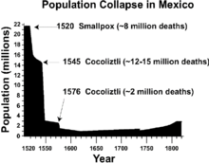
Extinction
When a predator or a competing species migrates from another deme, rapid extinction may occur.
A similar phenomenon can also occur within the same species, when some organisms carry diseases to which others don’t have immunity.

Slide 24
Evolution as Optimization
Free parameters (variables): genes
Possible values of parameters: alleles
Measured quality of a candidate solution: fitness
Goal: find the allele combination that results in the best fitness
Search process: natural selection along with mutation and recombination

Slide 25
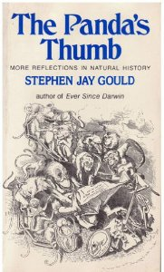
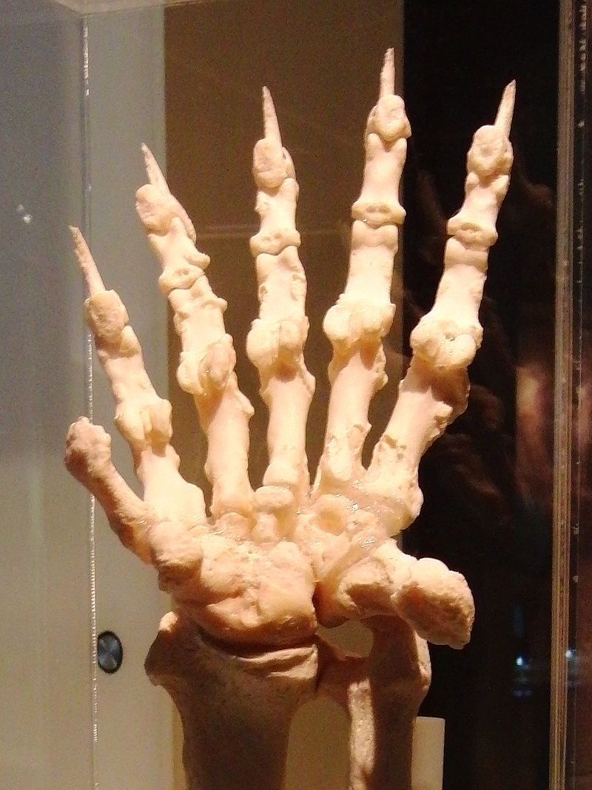
Multiple solutions exist to the same problem
Evolution may independently arrive at different ways of addressing the same problem.
[My interest in evolution followed reading a book by Stephen Jay Gould titled “The Panda’s Thumb”!]

